Slide 1


#LifeKoKaroLift
Data Structures

Slide 2



Module Name- Graphs
Topic Name: Graphs and It’s Representation
Instructor : Rahul Kumar
EditEdit MasterMaster texttext stylesstyles

Slide 3

Today’s Agenda
Introduction to Graphs
Terminology
Edge List Representation
Adjacencey Matrix Representation
Adjacencey List Representation

Slide 4
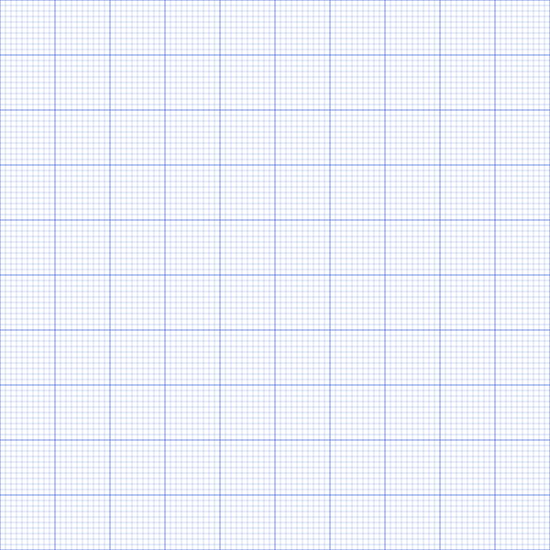
Introduction to Graphs
Isn’t this the first image that comes to your mind when you hear the word graphs???
Do you think the graphs used in programming will be relatable to the graphs you used in your school life???
Well there’s only one way to find out...Let’s study GRAPHS!!!

Slide 5
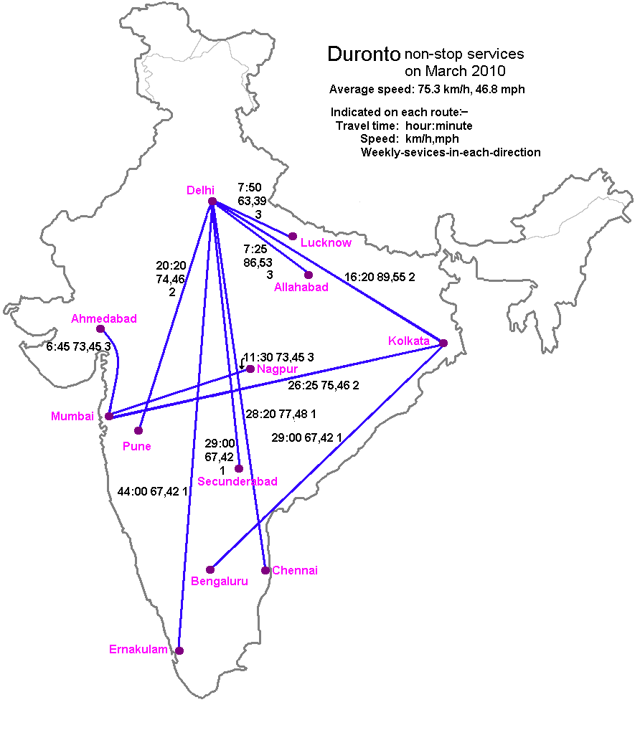
Introduction to Graphs
Here’s a map showing the Duronto train services in India as of March 2010.
Which data structure do you think is best to represent such form of data?
It is quite clear that using a linear data structure isn’t the best choice as it will get very complicated.
So, do you think trees and heaps can provide a solution to this???

Slide 6
Introduction to Graphs
If you have noticed, despite being non-linear data structures, trees and heaps have some sort of hierarchical flow from parent nodes to children nodes, which is clearly undesirable in our problem here.
So, this brings us to our newest and one of the most versatile and used abstract data structure, GRAPH.
Graph data structures can represent the relationship between different objects/entities. Here, the entities are called as nodes(vertices) and the relationship is called as edges(arcs).

Slide 7
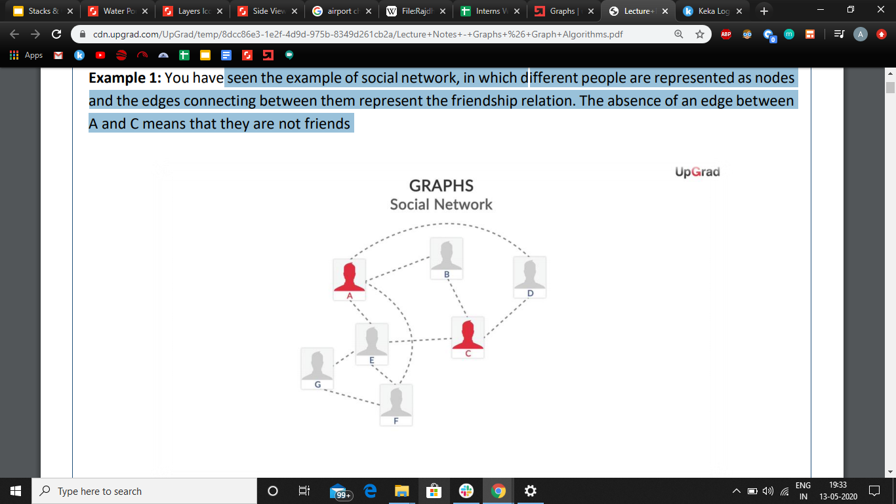
Introduction to Graphs
We can also use graphs to represent a social network
In this example, different people are represented as nodes and the edges connecting between them represent the friendship relation.
The absence of an edge between A and C means that they are not friends

Slide 8
Introduction to Graphs
The mathematical definition of graph states that:
G = (V, E) Here G is a graph which is a pair of two sets where:
V - It is a finite set of vertices (nodes).
E - It is a finite set of an ordered pair of the form (u, v) called an edge. The pair (u, v) indicates that there is an edge from vertex u to vertex v.

Slide 9
Introduction to Graphs
Graphs play a critical role in the application of social networks, transportation networks, etc. Certain applications of the graph data structure are:
Graphs help in finding the shortest distance between any two given locations, where nodes can be the different locations in a city and edges represent the routes available between the locations.
Graphs help in identifying contacts on social sites and suggesting them as friends on Facebook, where the nodes can be different users and the edges represent the relationships between them.

Slide 10
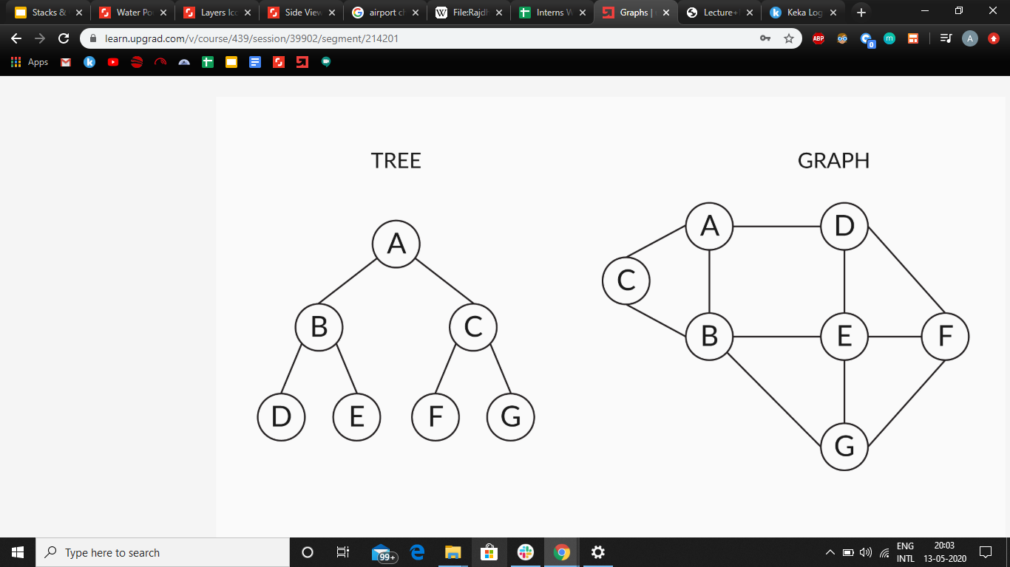
Introduction to Graphs
Graph data structures do not follow any restriction like that of the tree data structure on how different nodes are connected to each other.
Tree data structures have usage restrictions in representing real-world scenarios as each child node can have only one parent node.

Slide 11


Introduction to Graphs
Let’s move back to our example of social networks represented by graphs.
Let’s assume that the person ABC is related to XYZ. Does that mean that XYZ is also related back to the person ABC???
Well, if we take the example facebook, this relation does not have any direction because both of them can be friends or not.
But what about Instagram, does all your following follow you back? Do you follow back all your followers?

Slide 12
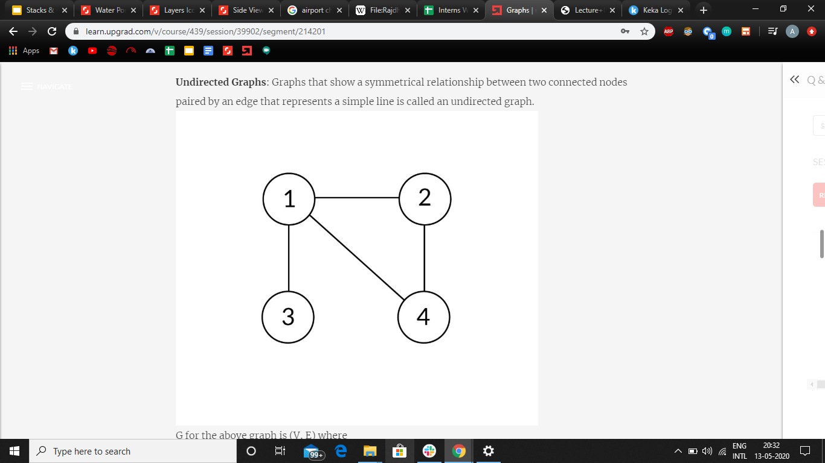
Introduction to Graphs
A graph that shows a symmetrical relationship between two connected nodes paired by an edge that represents a simple line segment is called an Undirected Graph.
The facebook social network is an example of Undirected Graph because only one of the two people needs to send the friend request and the relationship is established wherein both the people are equal.
Another example is the graph shown in the right image.

Slide 13
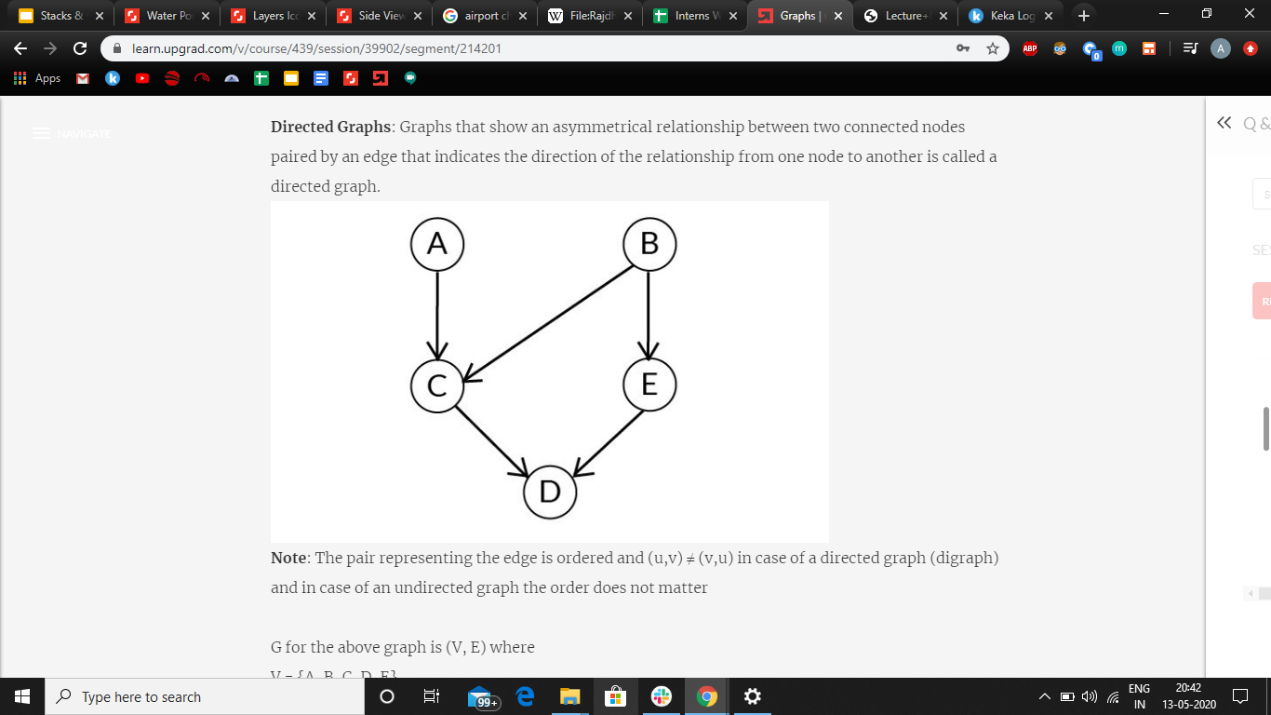
Introduction to Graphs
Graphs that show an asymmetrical relationship between two connected nodes and are paired by an edge that indicates the direction of the relationship from one node to another is called a directed graph.
The instagram social network is an example of directed graphs. This is because if someone accepts your follow request, it doesn’t imply that they become your follower too (unlike facebook). The relationship is unidirectional and they have to send a separate follow request for it to be bidirectional.
The given image shows another example.

Slide 14
Introduction to Graphs
Furthermore, these graphs (directed or undirected) may or may not have cycles in them.
The directed graphs that have cycles in them, i.e. if you start from any node in the graph and traverse through its connecting edges, you return to the same node where you started, are called Directed Cyclic Graphs.
Similarly, the directed graphs that don’t have any cycle in them are called Directed Acyclic Graphs(DAG).
The example of a Directed Cyclic Graph can be our instagram social network where A follows B, B follows C and C follows A. If no such cycle exists, it would be an example of DAG.

Slide 15
Introduction to Graphs
This is the same example we saw while learning about Directed Graphs. Is this an example of Directed Cyclic Graph or Directed Acyclic Graph???
Notes:
The answer is Directed Acyclic Graph.

Slide 16
Introduction to Graphs
Now we move on to a special type of Directed Acyclic Graph( DAG) and yes, it’s the same example we have been using.
There is a special kind of DAG which has the condition that no node can be related to two different nodes, like the node C and D in this example.
Can you try to guess what would we call such a DAG? Let’s see another example to help you visualize it better.

Slide 17
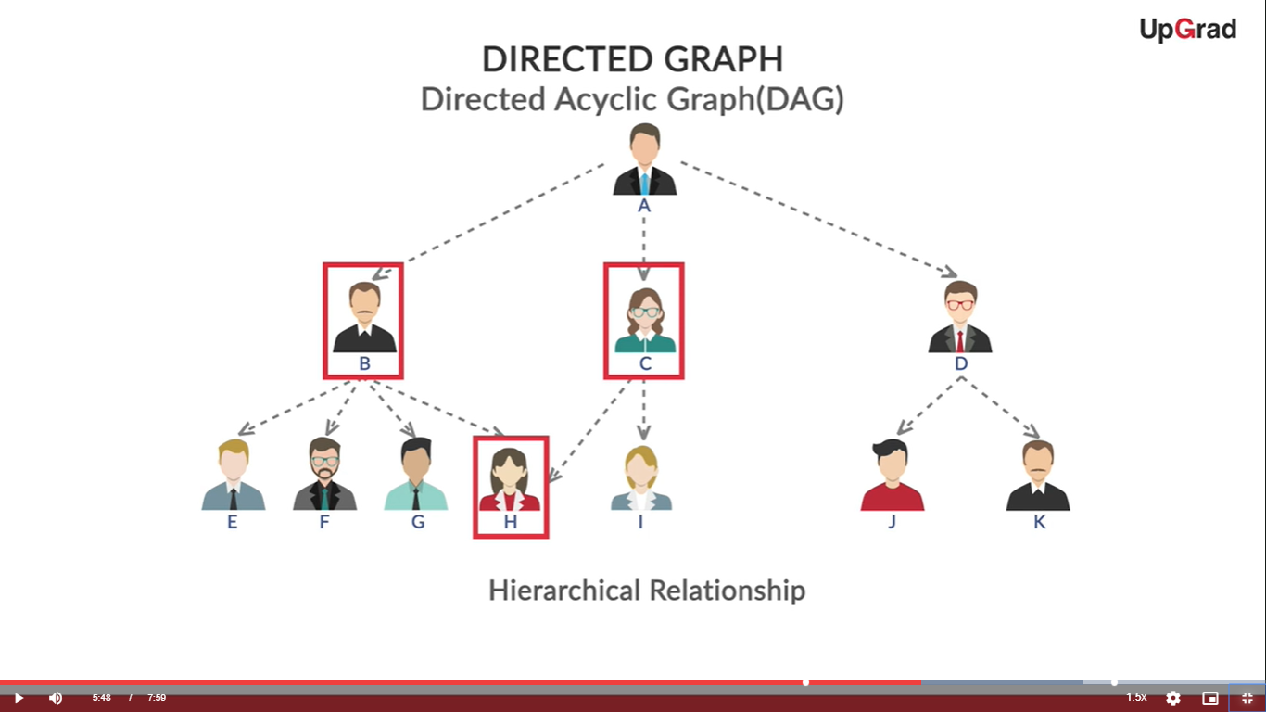
Introduction to Graphs
The given DAG has a person H who is related to both B and C( There is no such other node).
What if H was related to one and only one person, say B.
What would you call such a data structure?

Slide 18
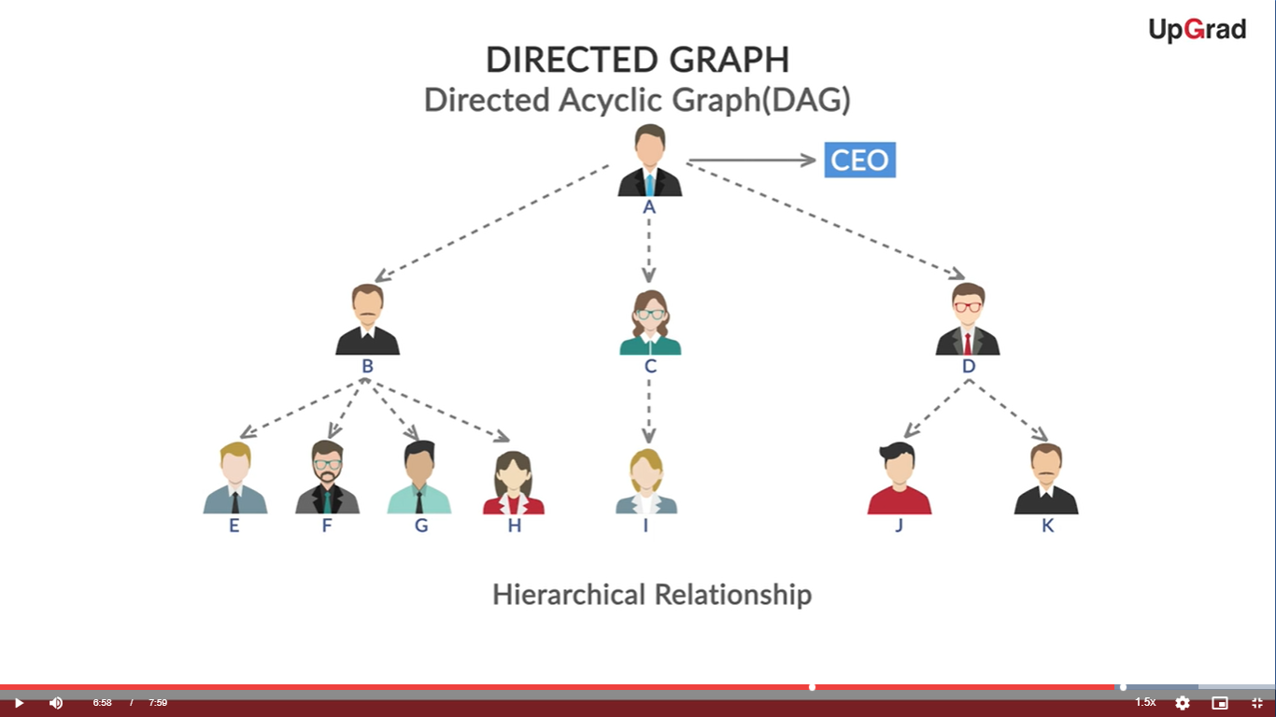
Introduction to Graphs
Well, you are right this kind of data structure is what we have already studied.
It’s an example of tree.
Therefore, we can safely say that all the trees are examples of graphs.

Slide 19
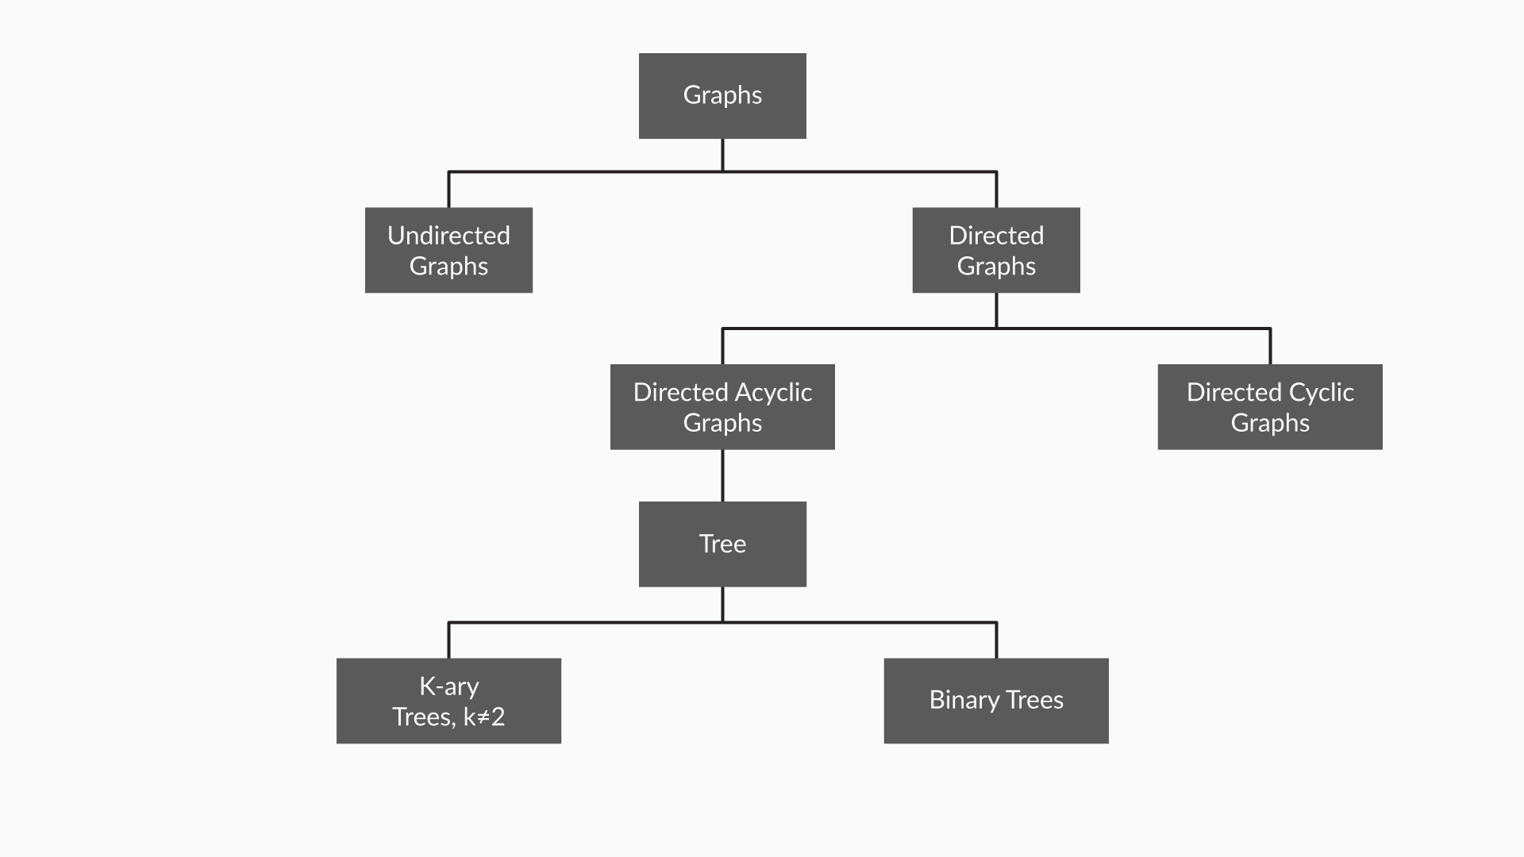
Introduction to Graphs
Let’s summarise what we learnt about the type of graphs:
Notes:
The answer is Directed Acyclic Graph.

Slide 20
Introduction to Graphs
There are two types of graphs on an another basis of differentiation:
Connected Graph: A Graph is connected if a path exists from every vertex to every other vertex.
Disconnected Graph: A Graph is disconnected if there exist at least two nodes such that there is no path connecting them.
Let’s see an example to solidify this theory:

Slide 21
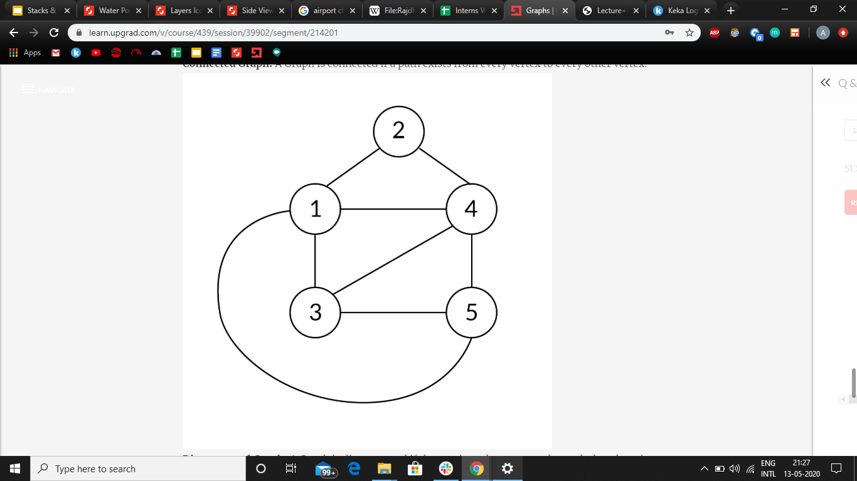
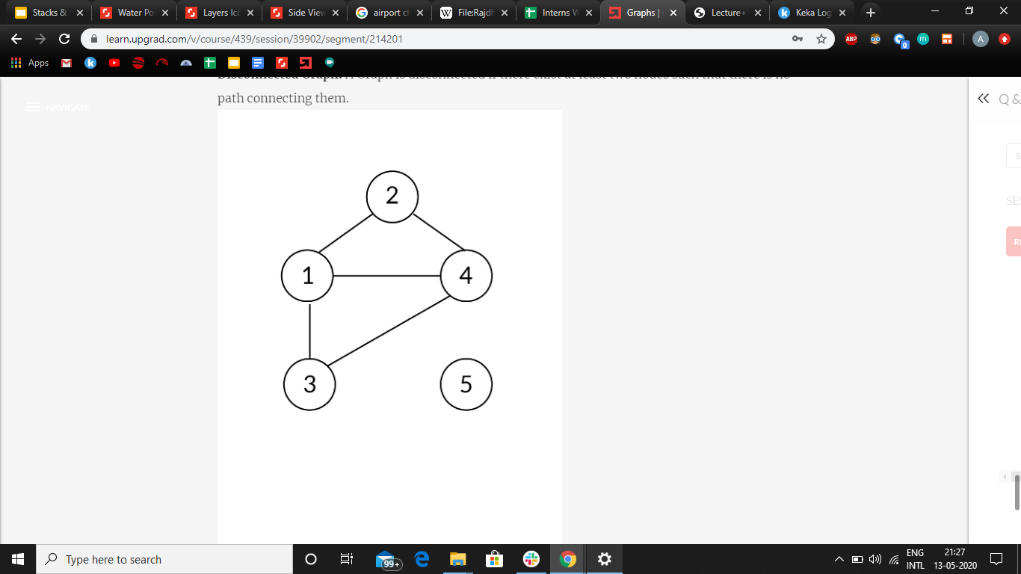
Introduction to Graphs
Let’s analyze the given two graphs carefully now:
In the first image( the top one), all the nodes seem to have one or more connection(s) with other nodes and hence all the nodes are connected to each other, either directly or indirectly. It is therefore, a connected graph.
But, in the bottom graph all the connections of node 5 are removed from the the above graph leaving no path from 5 to any of the node. Thus, it is a disconnected graph.

Slide 22
Terminology
Let’s now see the various terms related to this data structure:
Neighbours: If two nodes are adjacent to each other and connected by an edge, then those nodes are called neighbours.
Degree: The number of edges that are connected to a node is called the degree of that node. In directed graphs, the degree can be classified into:
In-degree: The number of incoming edges to a node
Out-degree: The number of outgoing edges from a node

Slide 23
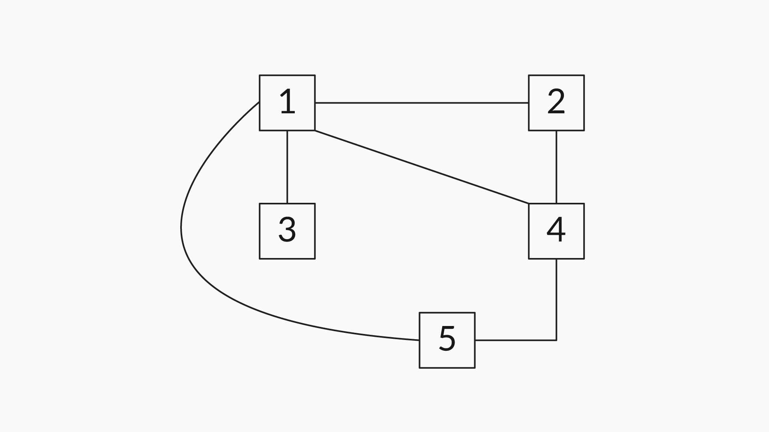
Terminology
For a directed graph:
Degree =In - Degree(the edges pointing to the vertex) + Out -
Degree(the edges pointing away from the vertex)
Well it’s time to test how well you understood the concept of neighbours and degree…
What will be the neighbours and degree of each of the nodes in the graph??

Slide 24
Terminology
You can verify your answers here...
Nodes | Neighbours | Degree
Node 1 | {2, 3, 4, 5} | 4
Node 2 | {1, 4} | 2
Node 3 | {1} | 1
Node 4 | {1, 2, 5} | 3
Node 5 | {1, 4} | 2

Slide 25
Terminology
Let’s move on to the next term:
Path:
When a series of vertices are connected by a sequence of edges between two specific nodes in a graph, the sequence is called a path.
For example, in the given graph, {2, 1, 4, 5} indicates the path between the nodes 2 and 5, and the intermediate nodes are 1 and 4.

Slide 26
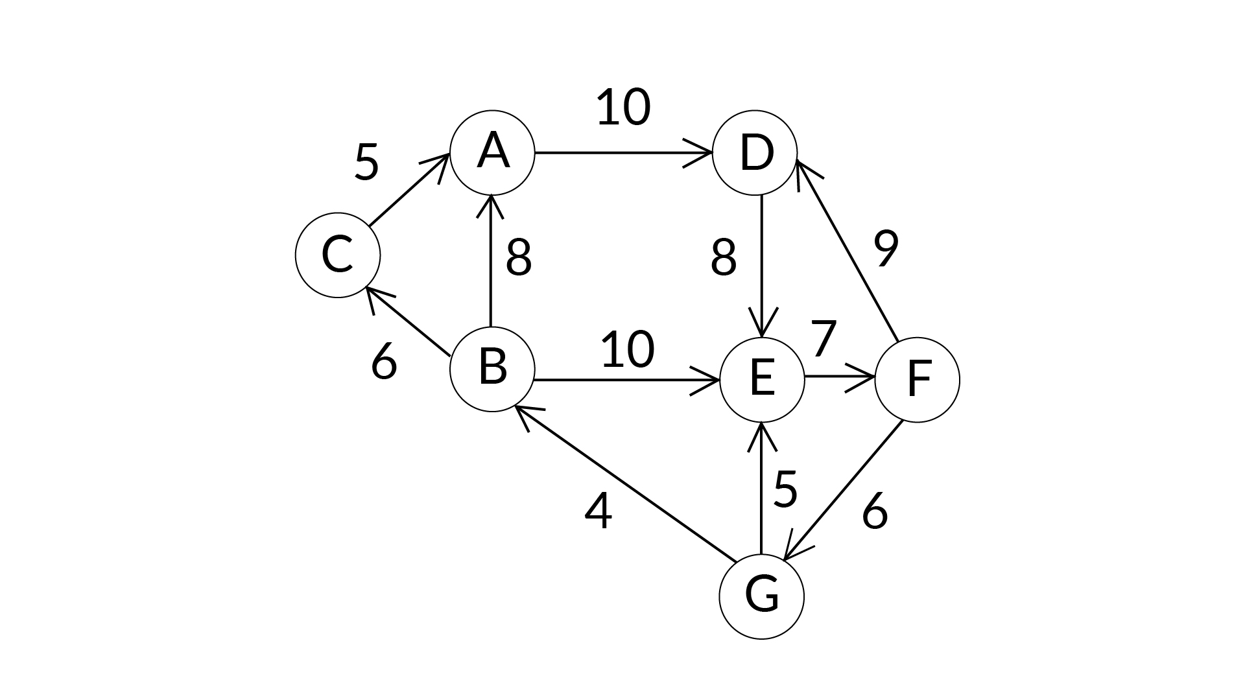
Terminology
Weighted graph:
A graph in which edges contain some weights or values is called a weighted graph.
Example: If the nodes in the graph are considered as the cities and edges considered as the paths between them then the weights of these edges can be considered as the distance between these cities.

Slide 27
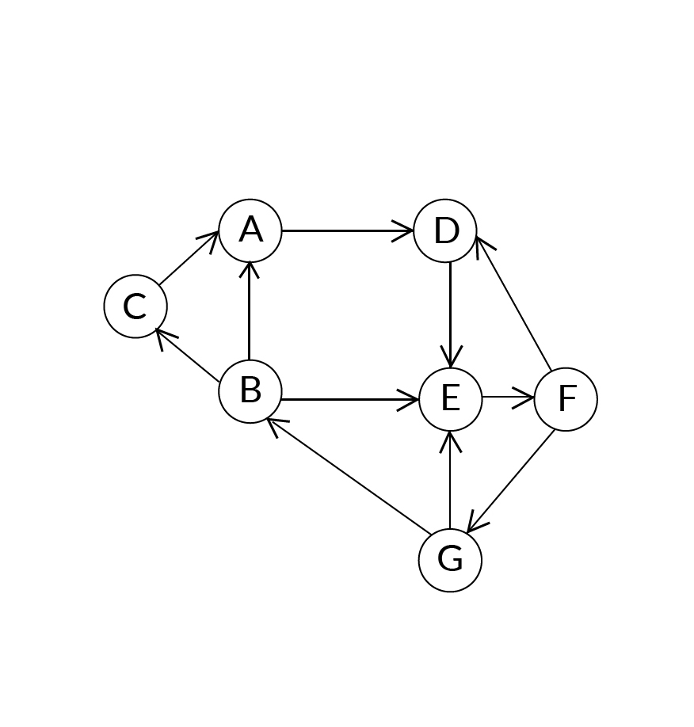
Terminology
Unweighted graph:
A graph in which edges contain no weight is called the Unweighted Graph.
Example: If the edges from previous example do not have any weights assigned to them, the it becomes an unweighted graph.

Slide 28
Introduction to Edge Lists
We completed both the traversal techniques for the graphs and now it’s time to study the implementations.
There are three key implementations of the graph abstract data structure:
Edge list
Adjacency matrix
Adjacency list

Slide 29
Introduction to Edge Lists
We completed both the traversal techniques for the graphs and now it’s time to study the implementations.
There are three key implementations of the graph abstract data structure:
Edge list
Adjacency matrix
Adjacency list

Slide 30
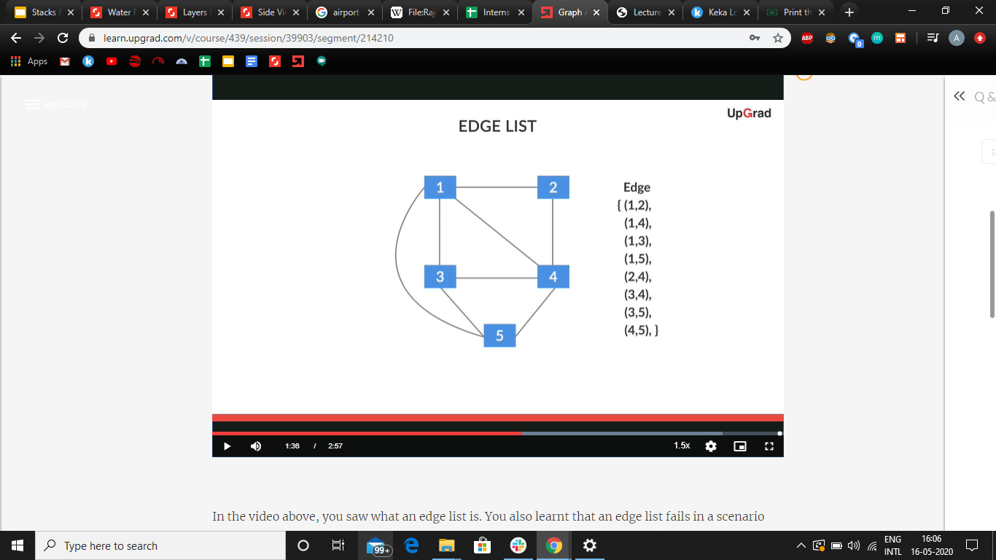
Introduction to Edge Lists
Let’s start with the first implementation called Edge List.
As the name suggests, edge list is a list of all the edges of the graph.
Let’s understand it with the help of same example we have been using:

Slide 31
Introduction to Edge Lists
As we can see, there are these edges between:
1 and 2
1 and 4
3 and 4 and so on
So all we have to do is to maintain a list of these edges.
This is done so that the edge list class would have an attribute named edges, and it’s the list of all the edges.

Slide 32
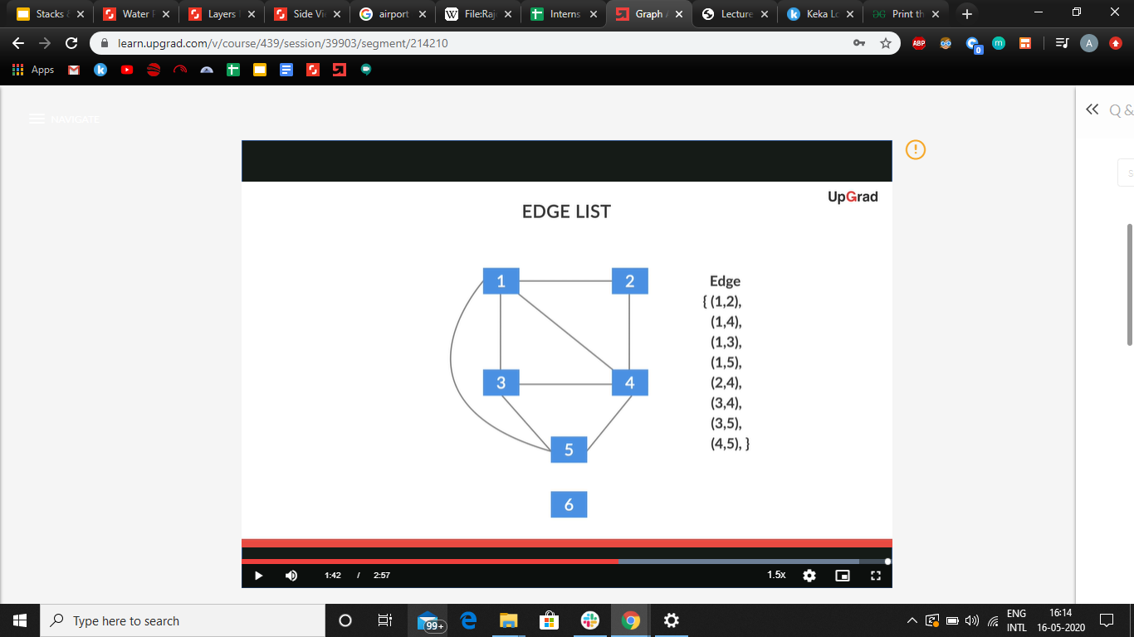
Introduction to Edge Lists
In this case, the edge list representation is sufficient to represent the whole graph.
But do you remember when we talked about disconnected graphs?
Consider the same graph but with an additional node this time.
Is the edge list sufficient to implement such a graph?

Slide 33
Introduction to Edge Lists
Since there is no edge connecting the node 6 to any other node, the edge list cannot represent this node 6 in the graph.
This is the major drawback of edge list when it comes to unconnected graphs.
But what is the solution to the problem? Can we modify our implementation to incorporate the isolated nodes as well?
Well, let’s see...

Slide 34
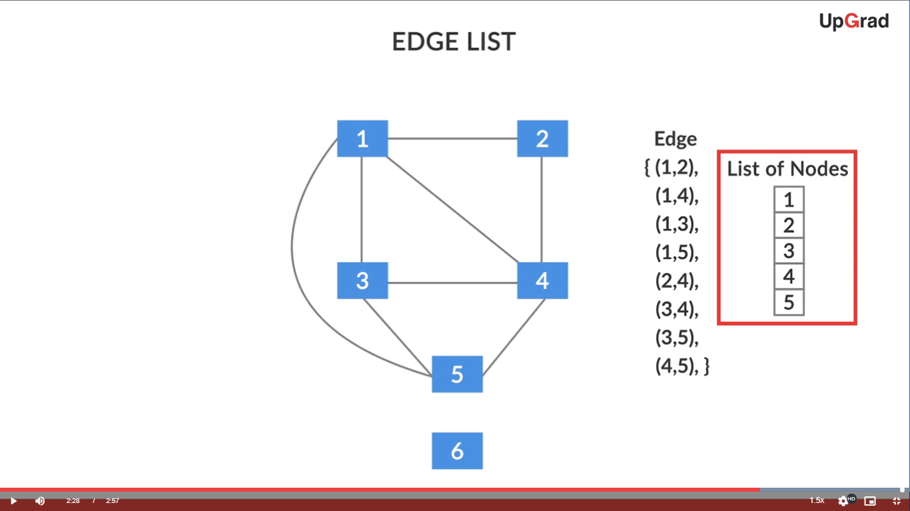
Introduction to Edge Lists
The solution to this problem is achieved by using an extra data structure, a SET to store all the nodes in the graph.
The new representation of the example we have been using is shown on the right.
So, if have to add a new isolated node now, we just add it to the LIST OF NODES and don’t update the EDGE LIST. Thus, we can represent both connected and unconnected graphs now

Slide 35
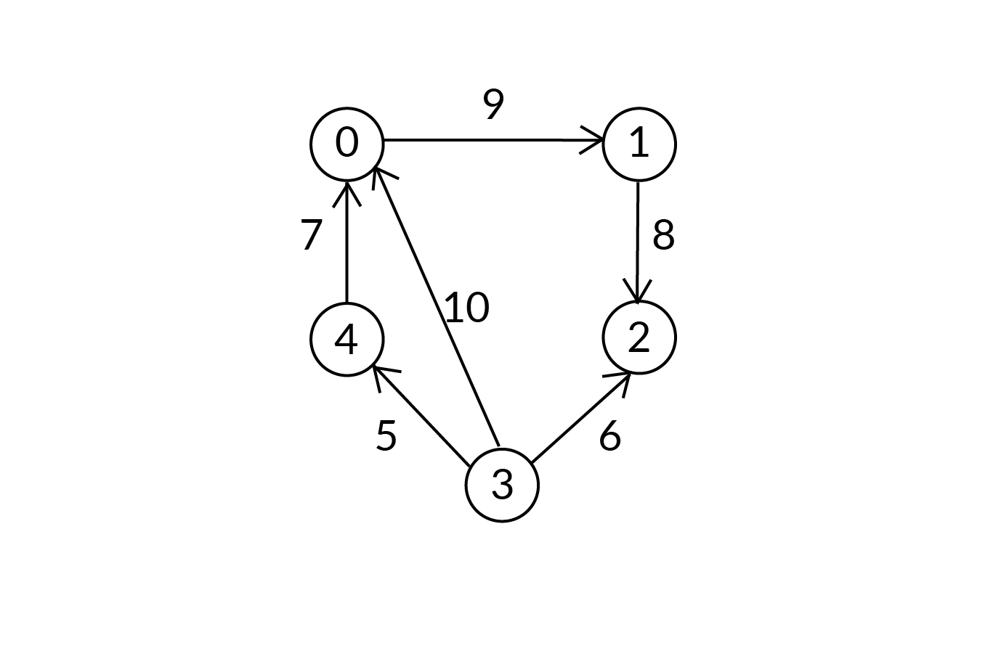
Introduction to Edge Lists
Let’s check how much you understood about the Edge List representation.
What will be the edge list representation of the following graph?

Slide 36
Introduction to Edge Lists
Since it’s a weighted graph, we need to add another value in our edge list object.
Set of nodes: {0, 1, 2, 3, 4}
Set of edges: {(0, 1, 9), (1, 2, 8), (3, 2, 6), (3, 0, 10), (4, 0, 7), (3, 4, 5)}
(0, 1, 9) indicates that there is an edge between ‘0’ and ‘1’ with edge weight as 9.

Slide 37
Introduction to Adjacency Matrix
Now let’s move on to the next representation of graph called the Adjacency Matrix.
As the name suggests, an adjacency matrix is a two-dimensional boolean matrix that represents a connection between nodes.
Here, the number of rows and the number of columns are the same and equal to the number of nodes in the graph.
Each row and each column corresponds to a particular node.

Slide 38
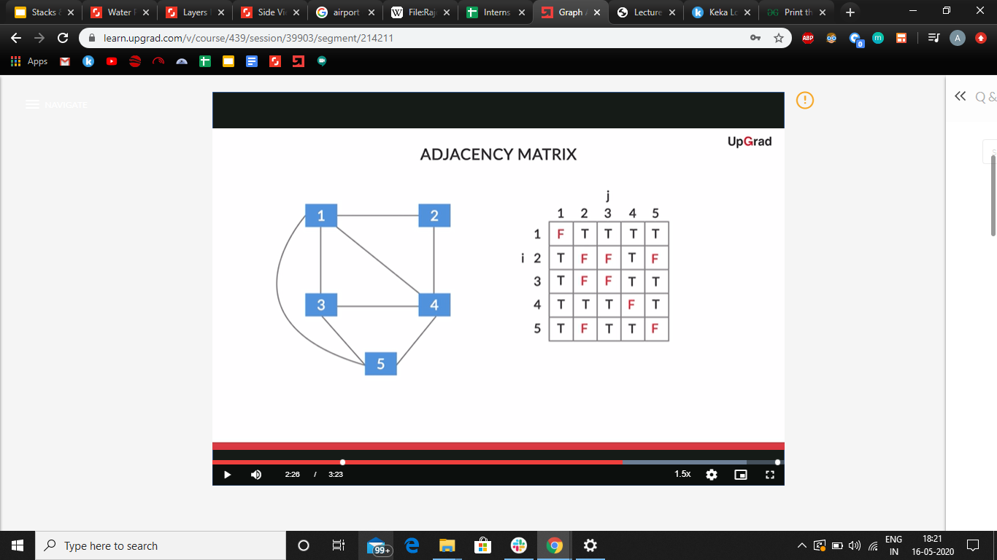
Introduction to Adjacency Matrix
The logic to populate this matrix is that if there exists, an edge between the node I and node J then you would place a true value in the cell corresponding to the Ith row and J^{th} column.
The Adjacency Matrix of the graph we’ve been using in our examples will be:

Slide 39
Introduction to Adjacency Matrix
The most important aspect of any algorithm is its performance characteristics, which determine how it will perform in a given situation or circumstance.
Now, we will calculate the time complexity for some operations on the adjacency matrix, specifically for the following four operations:
getAllNodes: Get all nodes of the graph.
addNode: Add anode to the graph.
addEdge: add an edge between the two specified nodes.
getAllNeighbours: Gets all neighbours of the specified node.

Slide 40
Introduction to Adjacency Matrix
getAllNodes:
This function converts a list of nodes into a set of nodes.
Therefore, the time complexity is O(n).
addNode:
It involves the creation of a new 2-D adjacency matrix of size n*n.
Then, all the contents of the previous adjacency matrix have to be transferred in the new one.
Therefore, the time complexity is the product of number of rows(n) and columns(n) i.e. O(n²).

Slide 41
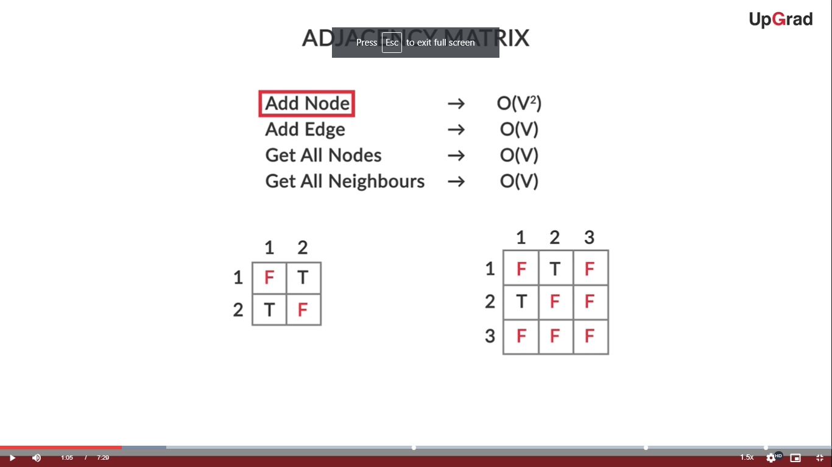
Introduction to Adjacency Matrix
addNode:
Let’s say we have to insert a new node in a graph containing only two nodes which are joined.
The first step will be to create a new 3X3 matrix and copy the first two rows and columns into it and filling the last row and column with False.
Now, depending on which nodes is the new node connected to, the corresponding entry in the matrix is made True.

Slide 42
Introduction to Adjacency Matrix
addEdge:
This function updates the adjacency matrix value to TRUE at the row and column corresponding to the nodes between which the edge is to be added.
This updation is very fast, but finding the row and column corresponding to these nodes uses the “IndexOf’’ operation on the node list.
The worst case time complexity of “IndexOf” and hence, the entire function is O(n).

Slide 43
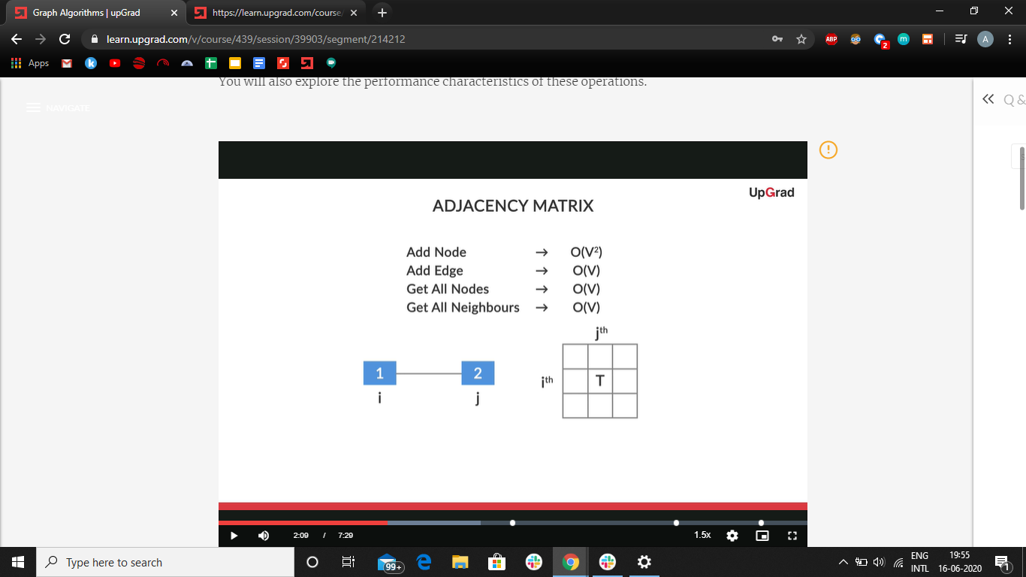
Introduction to Adjacency Matrix
addEdge:
For example, if an edge has to be added between nodes 1 and 2 of with indices ‘i’ and ‘j’, the entry corresponding to i^{th} row and j^{th} column is set to TRUE.
Also, the symmetric cell of Adjacency Matrix is also set to true.

Slide 44
Introduction to Adjacency Matrix
getAllNeighbours:
This function also first finds, the row/column number of the given node using IndexOf function just like addEdge.
In the next step, the entire row/column corresponding the node index is traversed and all the columns/rows with entry as TRUE are shown as neighbours.
Both the IndexOf function call and the row traversal for all columns take O(n) time and hence the overall time complexity of the function is O(n) as well.

Slide 45
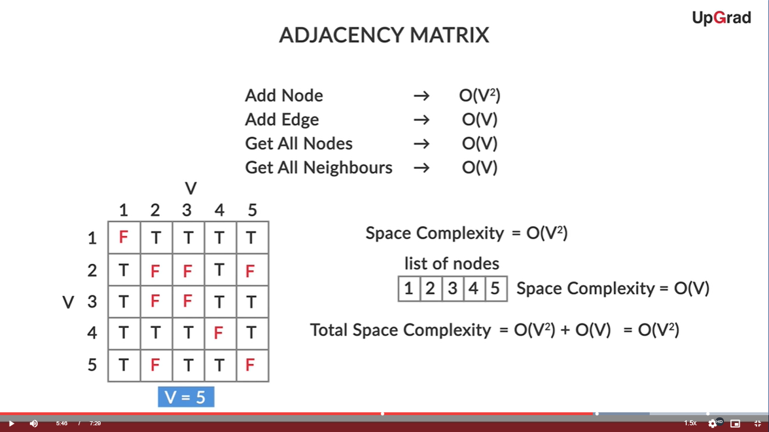
Introduction to Adjacency Matrix
If we analyse the space complexity of these functions, they contain an adjacency matrix of size n² and a list of nodes of size n. Thus, the overall space complexity becomes O(n+n²) = O(n²). Let’s summarize:

Slide 46
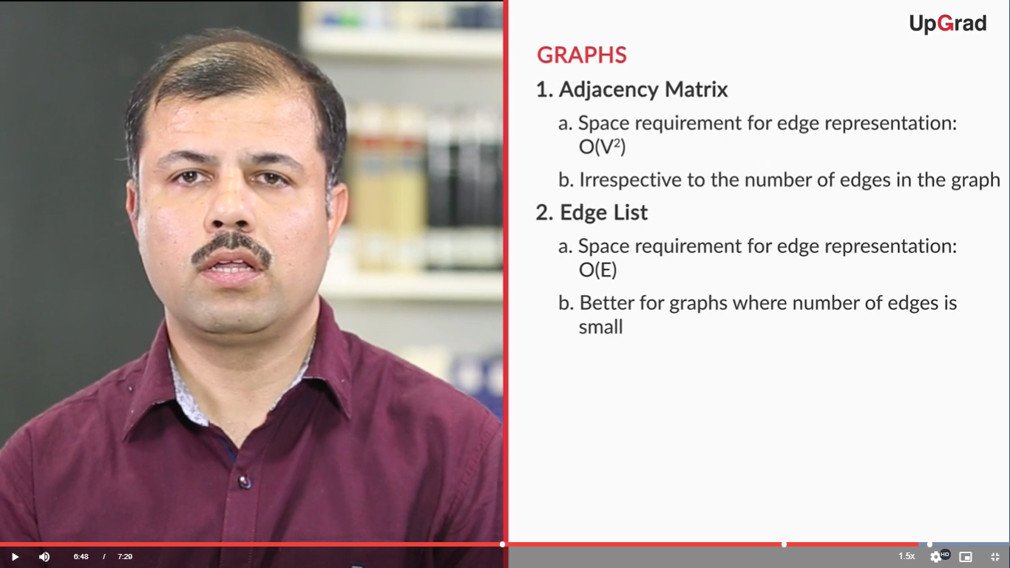
Introduction to Adjacency Matrix
On doing the comparison of space complexities of Edge List and Adjacency Matrix, we can say that:
Note that V represents the number of nodes/vertices and E the number of edges.

Slide 47
Introduction to Adjacency Matrix
This brings us to the concept of dense and sparse graphs.
Dense graphs: A dense graph is a graph in which the number of edges is close to the maximum possible edges for a given set of nodes.
Sparse graphs: Sparse graphs are connected graphs with the minimum or a small number of edges connecting nodes. In sparse graphs, there may or may not be an edge between two nodes.
Let’s see the examples now:

Slide 48
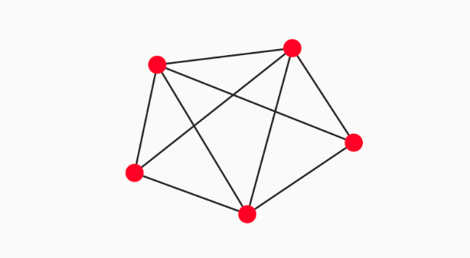
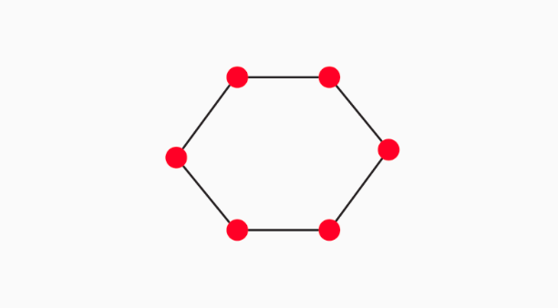
Introduction to Adjacency Matrix
Which of the above is a dense graph and which one is a scarce?
Notes:
Left is dense, right is scarce.

Slide 49
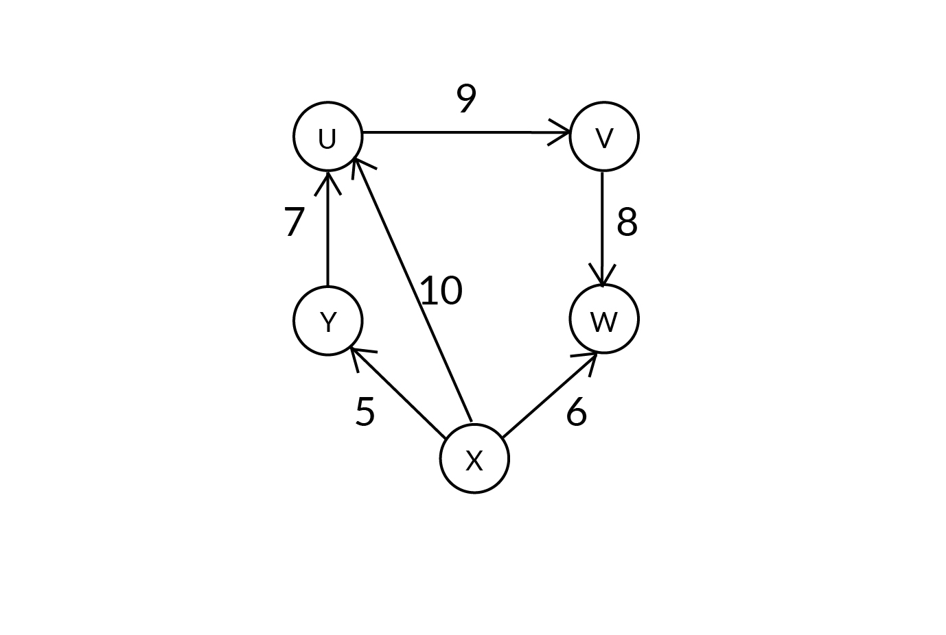
Introduction to Adjacency Matrix
What will be the Adjacency Matrix representation of the following graph?

Slide 50
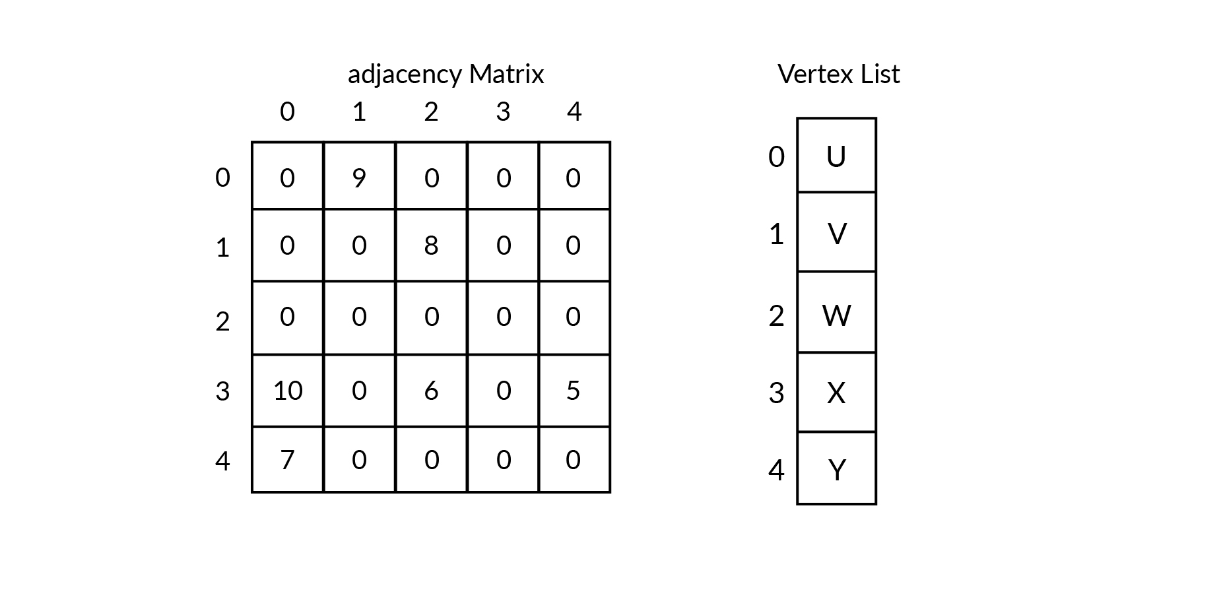
Introduction to Adjacency Matrix
Refer below for your answer:
Now, can you figure out a way to delete an edge, say from X to U?

Slide 51
Introduction to Adjacency Matrix
To delete the edge:
You have to traverse through the vertex list and find the indexes of the X and U, here they are 3 and 0 respectively.
If the size of the vertex list is V then this step takes linear time which is O(V) in the worst case.
Now set that (3,0)th cell to ‘0’.
This step takes constant time
The total time taken to delete an edge is O(V).

Slide 52
Introduction to Adjacency List
Now we move on to our final implementation of graph interface, Adjacency List:
This is a list of key-value pairs or a table with each row corresponding to a node in the graph.
The key set will be all the nodes and the value for a key will be the set of all its neighbours.
As you might have guessed already, the java implementation of this representation uses a map.

Slide 53
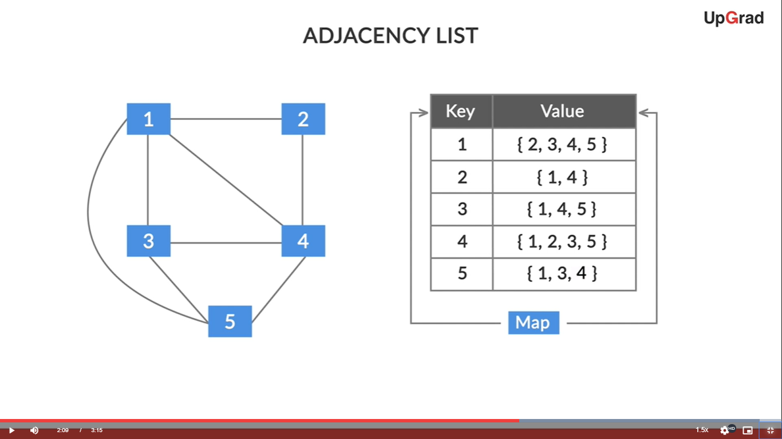
Introduction to Adjacency List
Let’s understand it better with the help of an example:
How will you add an edge, say 2-3 in this implementation???

Slide 54
Introduction to Adjacency List
To add an edge, we need to identify the two nodes which will be connected by the edge. In our case, they will be 2 and 3.
We need to find the first node(2) in our key set and add the second node(3) in its value set of nodes.
Similarly, we add the first node(2) in the value set of second node(3).
What will be the time complexity of the addEdge operation in Adjacency List implementation?

Slide 55
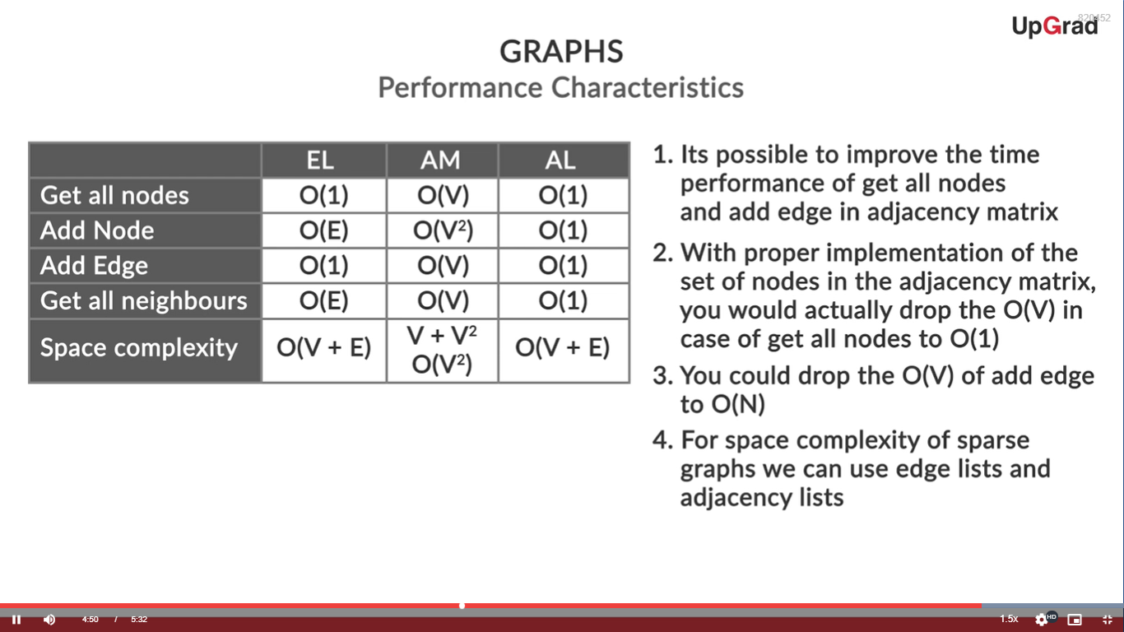
Introduction to Adjacency List
The following image compares performance characteristics of all the three implementations of graph:

Slide 56
Introduction to Adjacency List
Further, there are a few additional points to keep in mind:
It’s possible to improve the time performance of getAllNodes and addEdge functions in Adjacency Matrix.
With proper implementation of the set of nodes, The O(V) or O(n) of getAllNodes will drop to O(1).
Similarly, the performance of addEdge can be improved to O(1) as well.
Edge Lists and Adjacency Lists are recommended for sparse graphs and Adjacency Matrices for dense graphs on the basis of space complexities.
The adjacency list can be concluded as behaving the most optimally, but, again, this depends on the requirements.

Slide 57
#LifeKoKaroLift
Thank You! Happy learning!

